Slide 1
Chapter 19
Building E-Commerce
Applications and Infrastructure

Slide 2
Learning Objectives
Discuss the major steps in developing an EC application.
Describe the major EC applications and list their major functionalities.
List the major EC application development options along with their benefits and limitations.
Discuss various EC application outsourcing options, including application service providers (ASPs), software as a service (SaaS), and utility computing.
Discuss the major EC software packages and EC application suites.
Describe various methods for connecting an EC application to back-end systems and databases.

Slide 3
Learning Objectives
Discuss the value and technical foundation of Web Services and their evolution into second generation tools in EC applications.
Understand service-oriented architecture (SOA) and virtualization and their relationship to EC application development.
Describe the criteria used in selecting an outsourcing vendor and package.
Understand the value and uses of EC application log files.
Discuss the importance of usage analysis and site management.

Slide 4
Major E-Commerce Applications and Their Functionalities
B2C Storefronts
  An electronic storefront should have these functions:
    A product presentation function
    An order entry function
    An electronic payment function
    An order fulfillment function
    A customer service function
    The product support function

Slide 5
Major E-Commerce Applications and Their Functionalities
Supplier Sell-Side B2B Sites
  A B2B site has these additional features:
    Personalized catalogs and Web pages for all major buyers
    A B2B payment gate
    Electronic contract negotiation features
    Product configuration by customers
    Affiliate program capabilities
    Business alerts

Slide 6
Major E-Commerce Applications and Their Functionalities
E-Procurement
  Aggregating catalogs
  Reverse auctions and tendering systems
  Forward auctions
  Exchanges
  Portals
  Other EC systems

Slide 7
A Five-Step Approach to Developing an E-Commerce Landscape
Step 1: Identifying, Justifying, and Planning EC Systems
Step 2: Creating an EC Architecture
  EC architecture
  A plan for organizing the underlying infrastructure and applications of a site

Slide 8
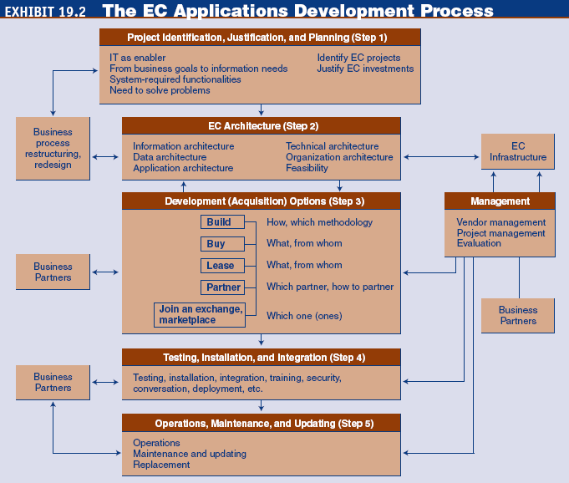
A Five-Step Approach to Developing an E-Commerce Landscape

Slide 9
A Five-Step Approach to Developing an E-Commerce Landscape
Step 3: Selecting a Development Option
Step 4: Installing, Testing, Integration, and Deploying EC Applications
  Unit testing
  Integration testing
  Usability testing
  Acceptance testing
Step 5: Operations, Maintenance, and Updating

Slide 10
A Five-Step Approach to Developing an E-Commerce Landscape
  unit testing
  Testing application software modules one at a time
  integration testing
  Testing the combination of application modules acting in concert
  usability testing
  Testing the quality of the user’s experience when interacting with a Web site
  acceptance testing
  Determining whether a Web site meets the original business objectives and vision

Slide 11
A Five-Step Approach to Developing an E-Commerce Landscape
Managing the Development Process
  The development process can be fairly complex and must be managed properly
  For medium-to-large applications, a project team is usually created to manage the process and the vendors
  Collaboration with business partners also is critical

Slide 12
Development Options for
E-Commerce Applications
In-House Development: Insourcing
  reusability
  The likelihood a segment of source code can be used again to add new functionalities with slight or no modification
  interoperability
  Connecting people, data, and diverse systems. The term can be defined in a technical way or in a broad way, taking into account social, political, and organizational factors
  insourcing
  In-house development of applications

Slide 13
Development Options for
E-Commerce Applications
  Development options
    Build from scratch
    Build from components
    Enterprise application integration

Slide 14
Development Options for
E-Commerce Applications
Buy the Applications
  turnkey approach
  Ready to use without further assembly or testing; supplied in a state that is ready to turn on and operate
Outsourcing/Leasing EC Applications
  outsourcing
  A method of transferring the management and/or day-to-day execution of an entire business function to a third-party service provider

Slide 15
Development Options for
E-Commerce Applications
utility (on-demand) computing
Unlimited computing power and storage capacity that can be used and reallocated for any application—and billed on a pay-per-use basis

Slide 16
Development Options for
E-Commerce Applications
  The utility-computing value proposition consists of three layers of tools:
    policy-based service-level-management tools
    Coordinate, monitor, and report on the ways in which multiple infrastructure components come together to deliver a business service
    policy-based resource-management tools
    Automate and standardize all types of IT management best practices, from initial configuration to ongoing fault management and asset tracking
    Virtualization tools

Slide 17
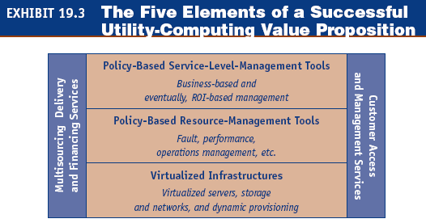
Development Options for
E-Commerce Applications

Slide 18
Development Options for
E-Commerce Applications
application service provider (ASP)
A company that provides business applications to users for a small monthly fee
software as a service (Saas)
A model of software delivery where the software company provides maintenance, daily technical operation, and support for the software provided to their client. SaaS is a model of software delivery rather than a market segment

Slide 19
Development Options for
E-Commerce Applications
Rise of Web Services and Service-Oriented Architecture
  Existing technologies make integration a difficult task because of:
    Platform-specific objects
    Dynamic environment
    Security barriers

Slide 20
Development Options for
E-Commerce Applications
Web Service
A software system identified by a URI (uniform resource indicator), whose public interfaces and bindings are defined and described using XML

Slide 21
Development Options for
E-Commerce Applications
  Key technologies in Web services
    Simple Object Access Protocol (SOAP)
    Protocol or message framework for exchanging XML data across the Internet
    Web Services Description Language (WSDL)
    An XML document that defines the programmatic interface—operations, methods, and parameters—for Web Services

Slide 22
Development Options for
E-Commerce Applications
    Universal Description, Discovery, and Integration (UDDI)
    An XML framework for businesses to publish and find Web Services online
    security protocol
    A communication protocol that encrypts and decrypts a message for online transmission; security protocols generally provide authentication

Slide 23
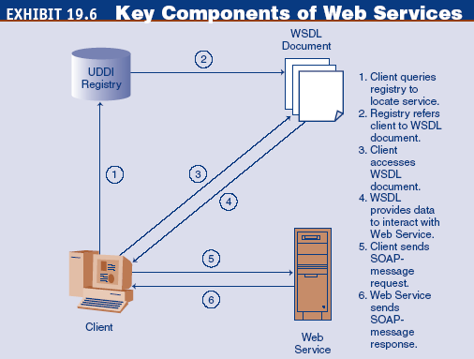
Development Options for
E-Commerce Applications

Slide 24
Development Options for
E-Commerce Applications
  Advantages of implementing Web Services
    Web Services rely on universal, open, text-based standards
    Web Services enable software running on different platforms to communicate
    Web Services promote modular programming
    Web Services are easy and inexpensive to implement
    Web Services can be implemented incrementally

Slide 25
Development Options for
E-Commerce Applications
  Barriers to implementing Web Services
    The standards underlying Web Services are still being defined
    One area where the Web Services standards are not well defined is security
    Although Web Services rely on XML as the mechanism for encoding data, higher-level standards are still required, especially in B2B applications
Second-Generation Web Services
  A second generation of Web Services is leading to less programming and more assembly, putting the power of the programmer into the hands of the user

Slide 26
Development Options for
E-Commerce Applications
  Web 2.0
  A second generation of Web Services that emphasizes online collaboration and information sharing among users
  social network
  A social network is a category of Internet applications that help connect friends, business partners, or other individuals together using a variety of tools
  Ajax
  A Web development technique for creating interactive Web applications

Slide 27
Development Options for
E-Commerce Applications
  Really Simple Syndication (RSS)
  A family of Web-feed formats used to publish frequently updated digital content
  viral video
  Video clip that gains widespread popularity through the process of Internet sharing, typically through e-mail or IM messages, blogs, and other media-sharing Web sites
  mashup
  Combination of two or more Web sites into a single Web site that provides the content of both sites (whole or partial) to deliver a novel product to consumers

Slide 28
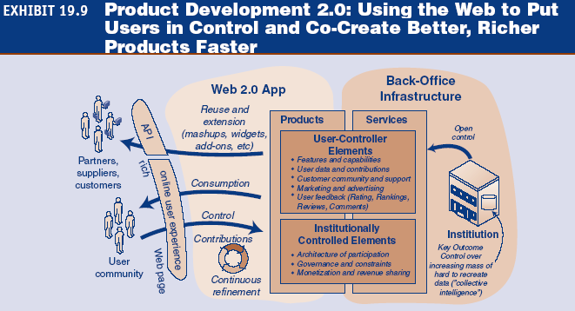
Development Options for
E-Commerce Applications

Slide 29
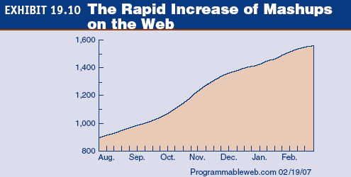
Development Options for
E-Commerce Applications

Slide 30
Development Options for
E-Commerce Applications
service-oriented architecture (SOA)
An application architecture in which executable components, such as Web Services, can be invoked and executed by client programs based on business rules

Slide 31
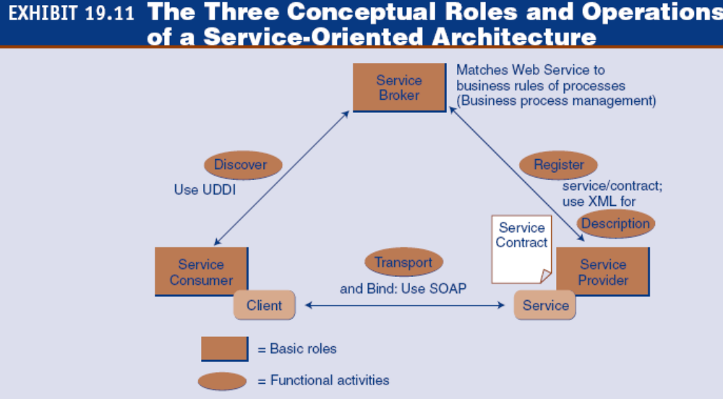
Development Options for
E-Commerce Applications

Slide 32
Development Options for
E-Commerce Applications
  An SOA system must supply four core functional architecture components:
    Transport
    Description
    Discovery
    Registration
  Benefits of service-oriented architecture
    Reduced integration cost
    Improved business/IT alignment
    Extension of leveraging of existing IT investments
    Faster time to assemble new applications
    Lowest IT maintenance cost

Slide 33
Development Options for
E-Commerce Applications
  Web-oriented architecture (WOA)
  A set of Web protocols (e.g., HTTP and plain XML) as the most dynamic, scalable, and interoperable Web Service approach
  Representational State Transfer (REST)
  Refers to a collection of architectural principles

Slide 34
Development Options for
E-Commerce Applications
  virtualization
  A technique for hiding the physical characteristics of computing resources from the way in which other systems, applications, or end users interact with those resources
  Benefits of virtualization
    Partitioning
    Isolation
    Encapsulation

Slide 35
Development Options for
E-Commerce Applications
Other Development Options
  Join an e-marketplace
  Join an auction or reverse auction third-party site
  Joint ventures
  Join a consortium
  Hybrid approach

Slide 36
Criteria for Selecting a Development Approach
These selection criteria need to be considered:
  Flexibility
  Information requirements
  User friendliness
  Hardware and software resources
  Installation
  Maintenance services
  Vendor quality and track record
  Estimating costs
  Personnel
  Technological evolution

Slide 37
Criteria for Selecting a Development Approach
  scalability
  How big a system can grow in various dimensions to provide more service; measured by total number of users, number of simultaneous users, or transaction volume
  Sizing

Slide 38
Criteria for Selecting a Development Approach
  Performance
    latency
    The time required to complete an operation, such as downloading a Web page
    throughput
    The number of operations completed in a given period of time; indicates the number of users that a system can handle
  Reliability
  Security

Slide 39
E-Commerce
Software Packages and Suites
Functional Software Packages
  electronic catalog
  The virtual-world equivalent of a traditional product catalog; contains product descriptions and photos, along with information about various promotions, discounts, payment methods, and methods of delivery
  merchant server software
  Software for selling over the Internet that enables companies to establish selling sites relatively easily and inexpensively

Slide 40
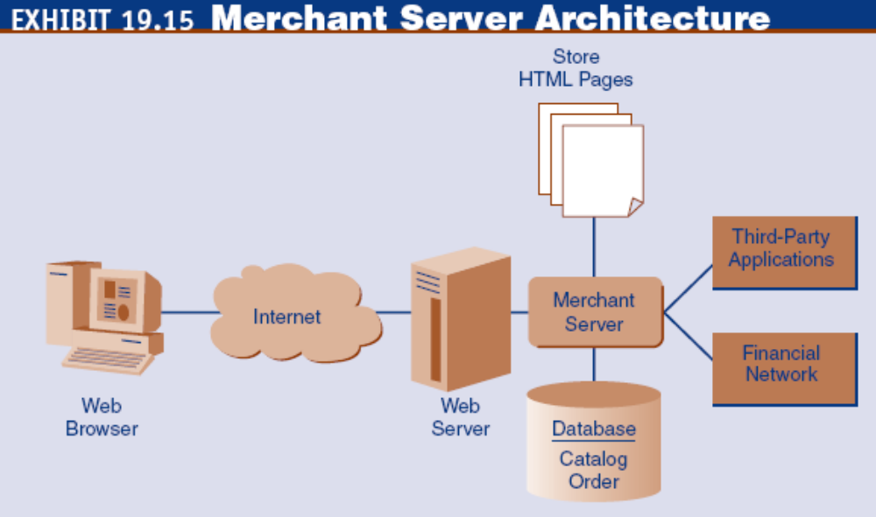
E-Commerce
Software Packages and Suites

Slide 41
E-Commerce
Software Packages and Suites
EC suite
A type of merchant server software that consists of an integrated collection of a large number of EC tools and components that work together for EC applications development

Slide 42
E-Commerce
Software Packages and Suites
Connecting To Databases
  multitiered application architecture
  EC architecture consisting of four tiers: Web browsers, Web servers, application servers, and database servers

Slide 43
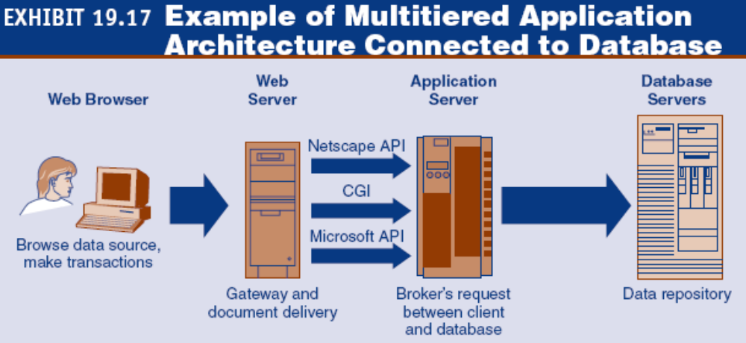
Connecting to Databases and Other Enterprise Systems

Slide 44
Connecting to Databases and Other Enterprise Systems
Integrating EC Applications and Back-End Systems
  enterprise application integration (EAI)
  Class of software that integrates large systems
  middleware
  Separate products that serve as the glue between two applications; sometimes called plumbing because it connects two sides of an application and passes data between them

Slide 45
Vendor and Software Selection
Six steps in selecting a software vendor and a package:
  Identify Potential Vendors
  Determine the Evaluation Criteria
    request for proposal (RFP)
    Notice sent to potential vendors inviting them to submit a proposal describing their software package and how it would meet the company’s needs

Slide 46
Vendor and Software Selection
  Evaluate Vendors and Packages
  Choose The Vendor and Package
  Negotiate a Contract
  Establish a Service-Level Agreement
    service-level agreement (SLA)
    A formal agreement regarding the division of work between a company and a vendor

Slide 47
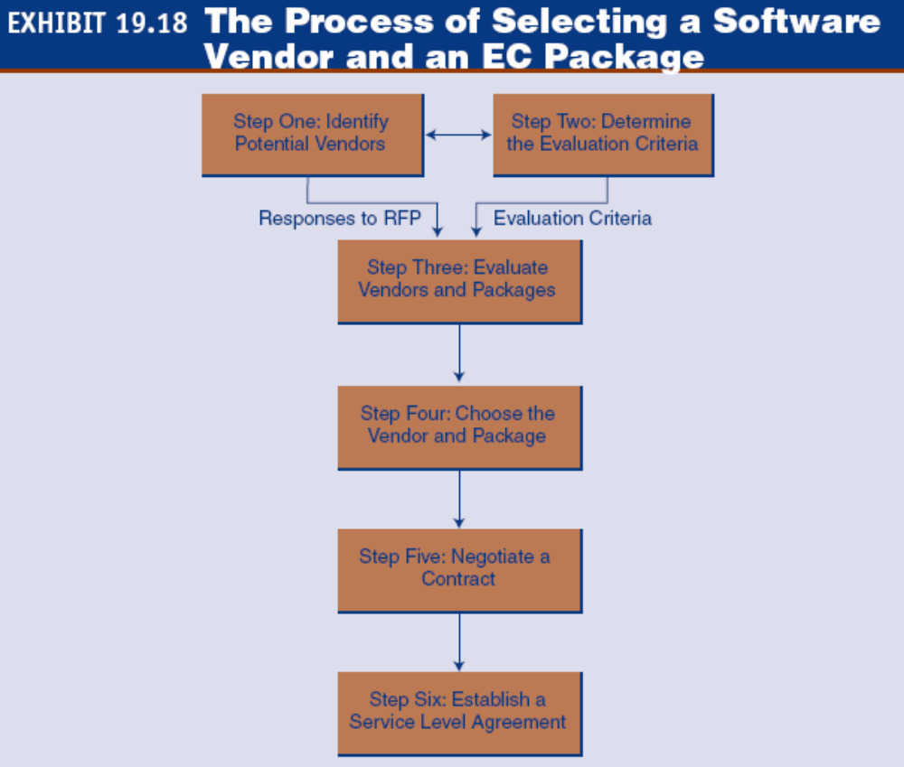
Vendor and Software Selection

Slide 48
Vendor and Software Selection
Usage Analysis and Site Management
  Log files
    access log
    A record kept by a Web server that shows when a user accesses the server; kept in a common log file format, each line of this text file details an individual access

Slide 49
Vendor and Software Selection
  Access logs provide statistics that can be used for analyzing and improving marketing and advertising strategies:
    Pageviews by time slot
    Pageviews by customers’ log-in status
    Pageviews by referrers
    Pageviews by visitor’s hardware platform, operating system, browser, and/or browser version
    Pageviews by visitor’s host

Slide 50
Managerial Issues
What is our business perspective?
Do we have a systematic development plan?
Insource or outsource?
How should Web Services be deployed?
How should we choose a vendor/software?
Have we analyzed the data?
Should users be involved?
How should we manage development risks?
How shall we plan for service-oriented architecture (SOA)?

